Slide 1
Ministry of Civil Aviation
Initiatives to Promote Tourism
March 29, 2023

Slide 2
Status of Civil Aviation in India
Until 2014, there were 74 operational airports in India. Presently the number of operational airports stands at 148.

Slide 3
Tourism RCS
In various UDAN rounds (3.0, 4.1, 4.2 & 4.3), Ministry of Tourism offered 132 routes, out of which 89 were awarded.

Slide 4
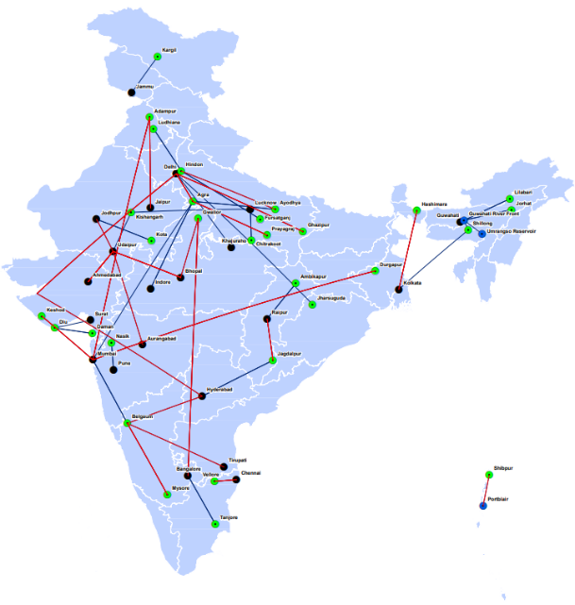
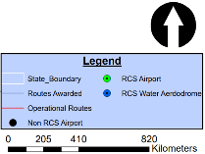
Tourism RCS – Awarded & Operationalized
These routes have provided connectivity all across the country by connecting previously unserved tourism routes.
Routes Awarded and Operationalized

Slide 5
TRCS- Buddhist Circuit
Current Status
Operational Airports in Buddhist Circuit:
International Airports: Varanasi, Gaya, Lucknow, Patna, Kushinagar;
Domestic Airports: Prayagraj, Kanpur
Amritsar
Nepal
Upcoming Airports:
Shravasti airport
Delhi
Shravasti
Jaipur
Kushinagar
Lucknow
Kanpur
Domestic Connectivity:
Varanasi and Patna : Ahmedabad, Bangalore, Mumbai, Kolkata, Delhi, Hyderabad, Chennai, Jaipur, Amritsar, Guwahati & Lucknow
Gaya : Delhi
Prayagraj
Patna
Guwahati
Varanasi
Gaya
Ahmedabad
Kolkata
Mumbai
International Connectivity:
Gaya: Yangon, Paro, Bangkok, Ho Chi Minh City (Total 681 departures planned- Winter 2019)
Charter Flights to Varanasi and Gaya : Myanmar, Vietnam, Thailand & Cambodia
Hyderabad
Bangalore
Chennai

Slide 6
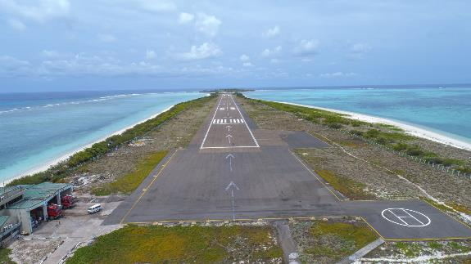
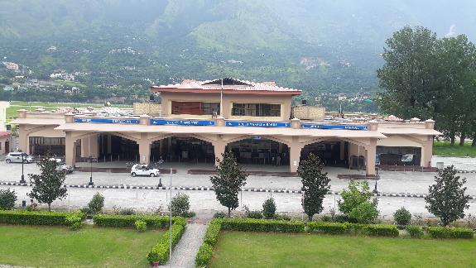
Potential Tourism RCS - Airports
Agatti Airport, Lakshadweep
Kullu Airport, Himachal Pradesh

Slide 7
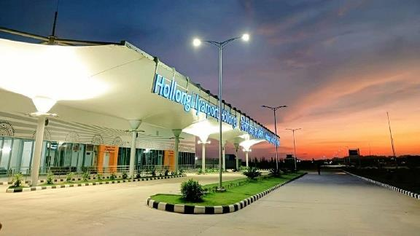
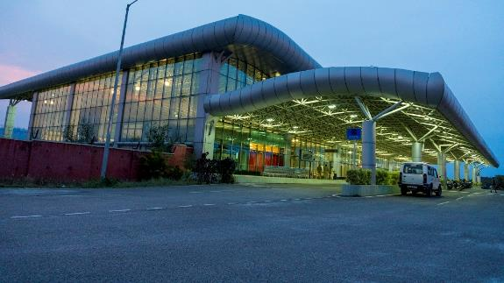
Tourism RCS - Airports
Donyi Polo Airport, Itanagar
Mysore Airport, Karnataka

Slide 8
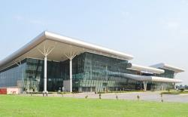
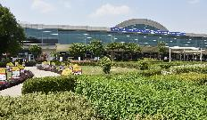
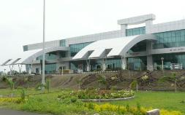
Tourism RCS Routes – Illustrative Examples
These examples show how recreational and religious tourist places are connected through TRCS
Khajuraho Airport
Amritsar
Nepal
Delhi
Agra
Itanagar
Varanasi Airport
Varanasi
Udaipur Airport
Udaipur
Guwahati
Patna
Khajuraho
Ahmedabad
Bhopal
Nanded
Bhubaneshwar
Amritsar Airport
Non-RCS Airport
Hyderabad
RCS Airport
Nanded Airport
Belgaum
Bangalore
Mysore

Slide 9
UDAN 4.3
UDAN 4.3 was a special single stage bidding round under UDAN 4 to award and operationalize pre-determined RCS Routes sponsored by the Ministry of Tourism
The routes under the bidding process have been pre-defined based on the proposals made by the Ministry of Tourism.
Only Individual Route Proposals allowed for the bidding process
All 10 routes awarded under the round have been operationalised

Slide 10
RCS – North-East Region
160 routes awarded to provide connectivity to North-East Region. Routes that are yet to be operationalized are expected to commence upon the readiness of the aerodromes.

Slide 11
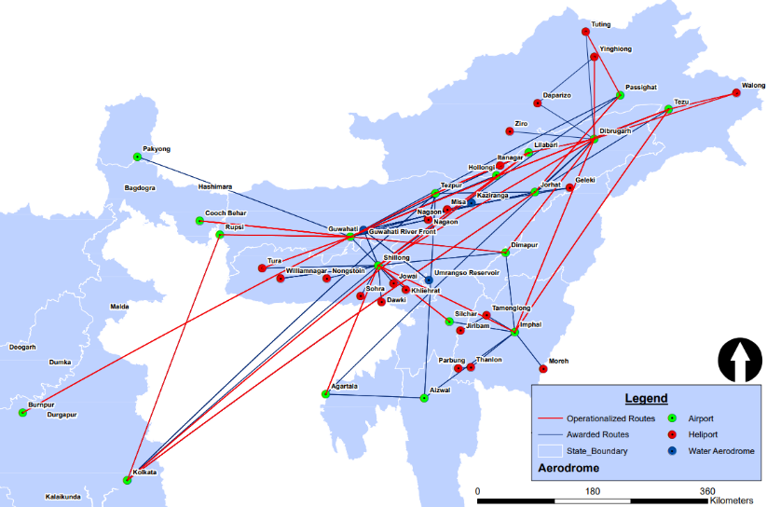
RCS – North-East Region – Awarded & Operationalized
These routes have provided connectivity all across the region by connecting previously unserved routes/ aerodromes.
Routes Awarded and Operationalized

Slide 12
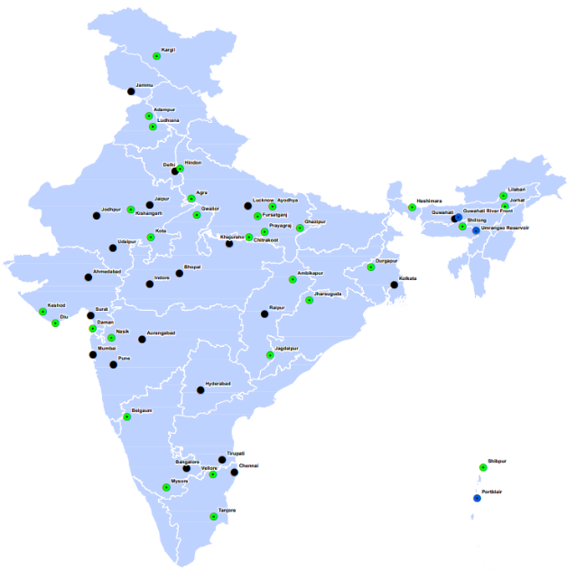
RCS Tourism Prospects
Aerodromes linked to TRCS
Small Aircraft Sub-Scheme (SAS) including helicopters and seaplanes was launched to connect unserved and underserved airports in the country with a focus on small airstrips
It will boost adventure tourism, religious tourism and other activities in remote regions of the country
RCS can also connect Priority Areas such as North-East, J&K, Himachal Pradesh, Uttarakhand, Lakshadweep, Andaman and Nicobar Islands

Slide 13
Thank You..

